Slide 1

MEDIA & THE PUBLIC
Week 11 Incidental news exposure
Ryan Wang
ryanyang@psu.edu

Slide 2
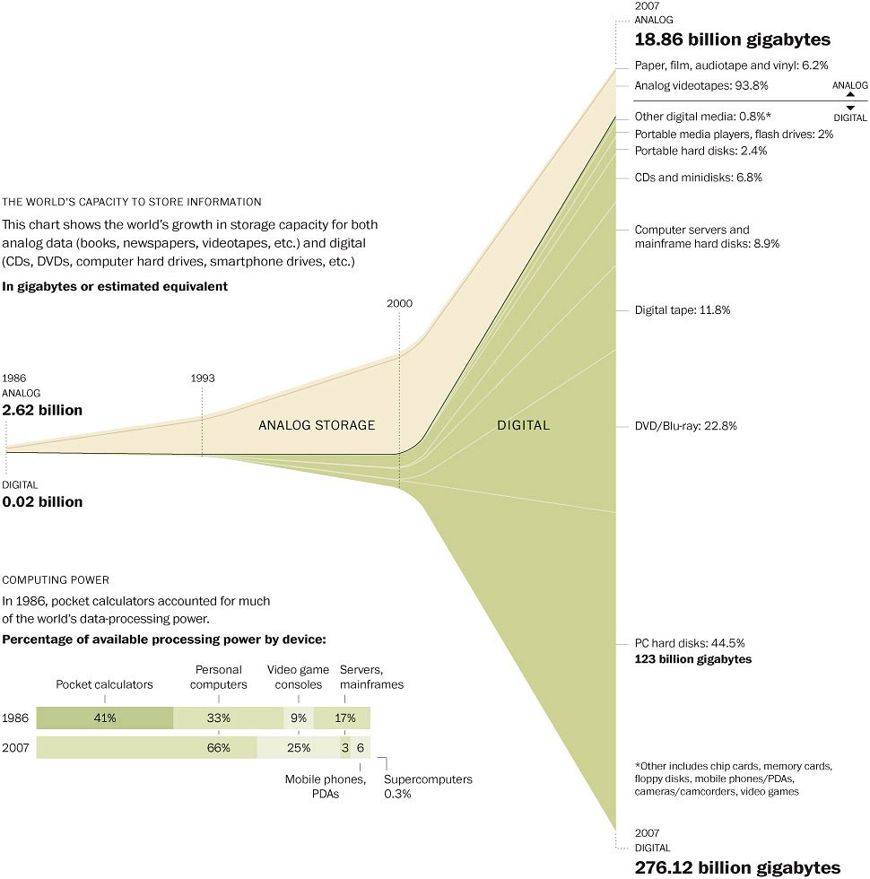



The rise of Internet and information capacity
Democratic theory, knowledgeable citizen and Internet

Slide 3
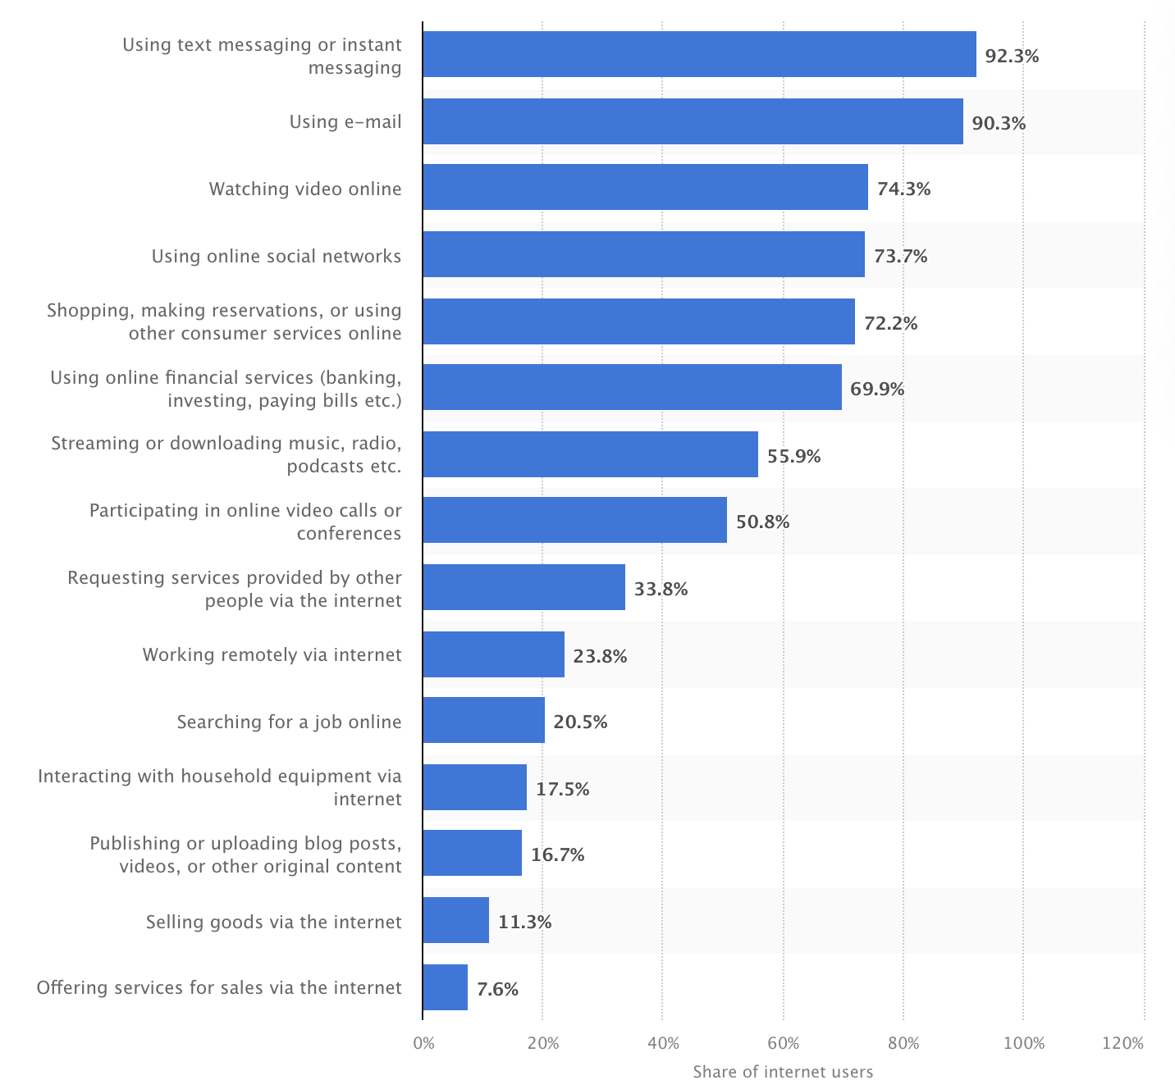
The rise of Internet and information capacity
But people are not always consuming political information
Source: Statista

Slide 4
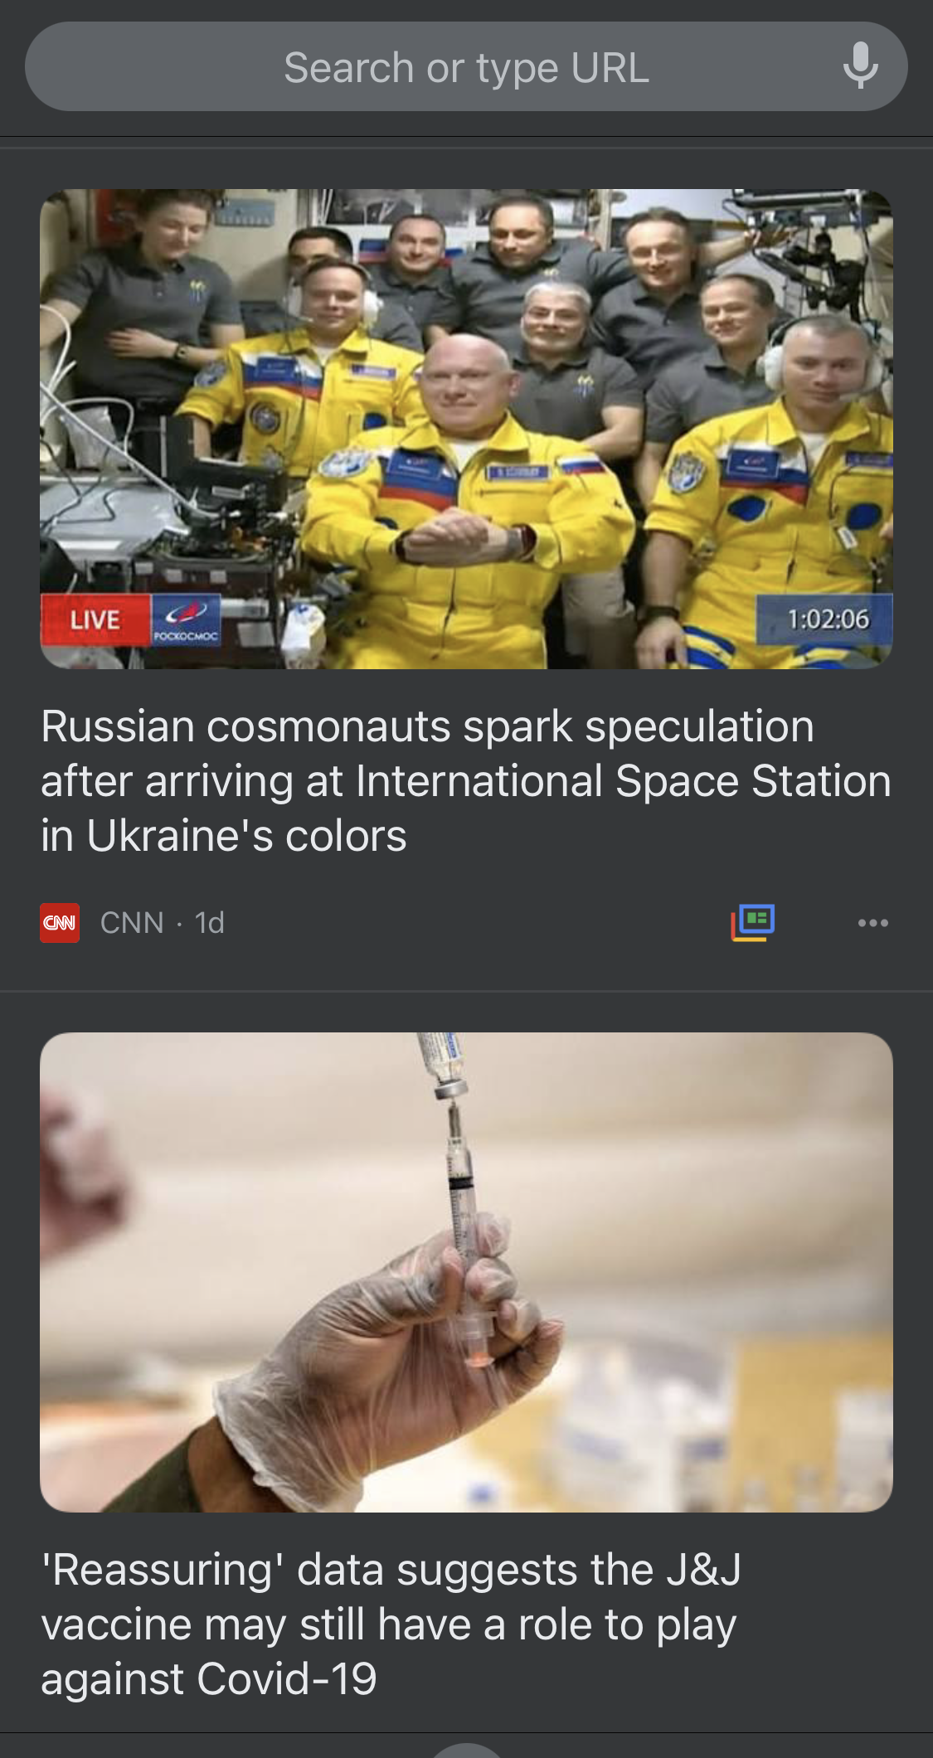
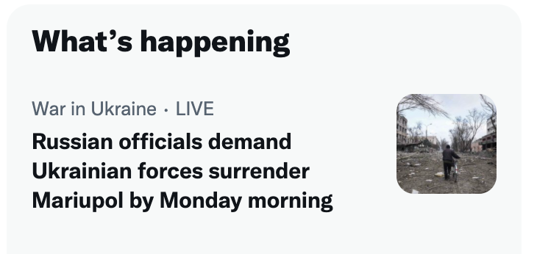
Active/Passive information seeking
Active information seeking
Uses & gratification
Surveillance
Passive information seeking
Incidental (news) exposure: Individual exposure to information that people encounter without actively seeking for it (Nanz & Matthes, 2020)
What have changed about incidental exposure on digital media (Weeks & Lane, 2020):
Curated flow of news
Network media logic
Opportunity cost

Slide 5
What is incidental (news) exposure (or not)
(Possible) Theoretical foundation
Passive learning: a lack of motivation to learn (Krugman and Hartley, 1970)
While this explanation fits when individuals only briefly glance at content, it may not explain other situations in which individuals focus their attention on incidentally encountered content
Rational choice theory (Downs, 1957)
It is rational for citizens to expend as few resources as possible obtaining the political information they need to figure out who to vote for; and news is more ‘freely’ available
Confusion?
Scenario 1: Passive scanning of information
When individuals briefly glimpse at an incidentally encountered headline or scroll past information someone stumbled upon
Scenario 2: Intentional processing of incidentally encountered information
When individuals read a full article after clicking on an incidentally encountered link as the same phenomenon
(Possible) Outcome:
Positive: political knowledge; civic participation
Neutral: No significant relationship
Negative
Notes:
An umbrella term for a set of diverse situation that involve exposure to information that respondents were not looking for:
While Valeriani and Vaccari (2016) found significant effects of IE on political participation cross-sectionally, longitudinal data by Heiss and Matthes (2019) suggests that IE even hampers participation.

Slide 6
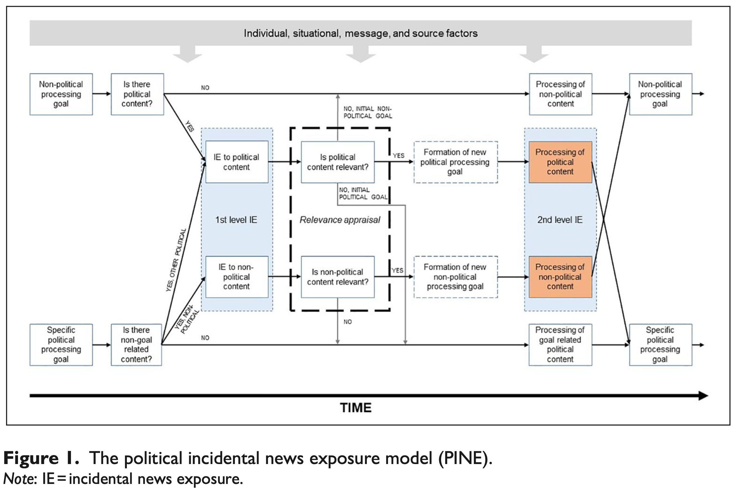
Political Incidental News Exposure (PINE) model (Matthes et al., 2020)

Slide 7
Political Incidental News Exposure (PINE) model (Matthes et al., 2020)
Individuals possess a processing goal at all times during media reception
A processing goal is the purpose of an individual to cognitively engage with content
Processing goals need to be understood as dynamic, as they may constantly change during reception
During reception, individuals constantly engage in relevance appraisal
When individuals encounter information online, they permanently check whether the information at hand is relevant
Two levels of incidental exposure
First-level: Passive scanning of information: lack a motivational driver they opt for scanning content with low engagement (passive learning)
Individuals encounter content that does not align with their processing goal
Individuals appraise this content as irrelevant
Second: Intentional processing of incidentally encountered information
Individuals regard incidentally encountered information as relevant
Individuals shift their cognitive resources toward incidentally encountered information
Two types of incidental exposure
Intention-based: political vs. non-political purpose
Topic-based: different political topics

Slide 8
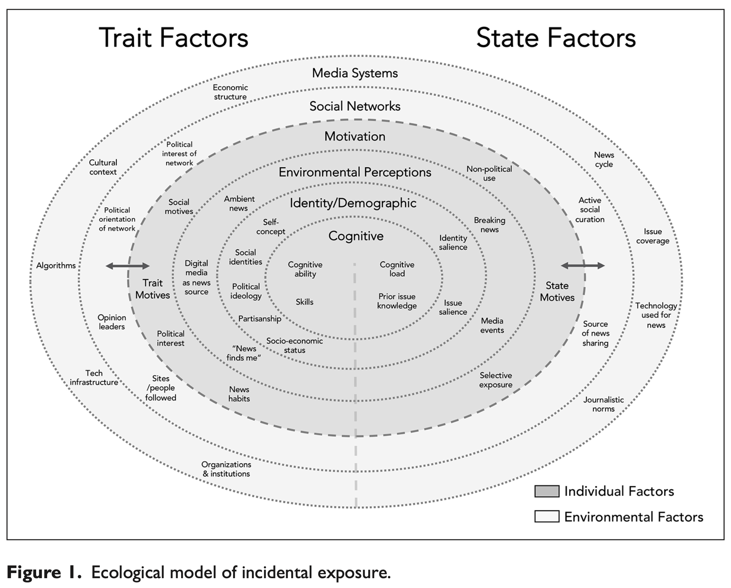
What might influence incidental (news) exposure (Weeks, 2020)
Notes:
“the extent to which individuals believe they can indirectly stay informed about public-affairs –despite not actively following news– through Internet use, information received from peers and online social networks” (Gil de Zúñiga et al., 2017, p. 107).

Slide 9
Reference
Downs, A. (1957). An Economic Theory of Democracy. Harper and Row
Krugman, H. E., & Hartley, E. L. (1970). Passive learning from television. Public Opinion Quarterly, 34(2), 184-190. https://doi.org/10.1086/267788
Matthes, J., Nanz, A., Stubenvoll, M., & Heiss, R. (2020). Processing news on social media. The political incidental news exposure model (PINE). Journalism, 21(8), 1031-1048. https://doi.org/10.1177/1464884920915371
Nanz, A., & Matthes, J. (2020). Learning from incidental exposure to political information in online environments. Journal of Communication, 70(6), 769-793. https://doi.org/10.1093/joc/jqaa031
Weeks, B. E., & Lane, D. S. (2020). The ecology of incidental exposure to news in digital media environments. Journalism, 21(8), 1119-1135. https://doi.org/10.1177/1464884920915354

